Slide 1
Carbon monoxide Gas Detector
Submitted to : Prof. Vittorio Scarano

Slide 2
Problem Area
Carbon monoxide (chemical formula CO) is a colorless, odorless, tasteless, flammable gas that is slightly less dense than air.
Carbon monoxide poisoning occurs when carbon monoxide builds up in your bloodstream. When too much carbon monoxide is in the air, your body replaces the oxygen in your red blood cells with carbon monoxide. This can lead to serious tissue damage, or even death.

Slide 3
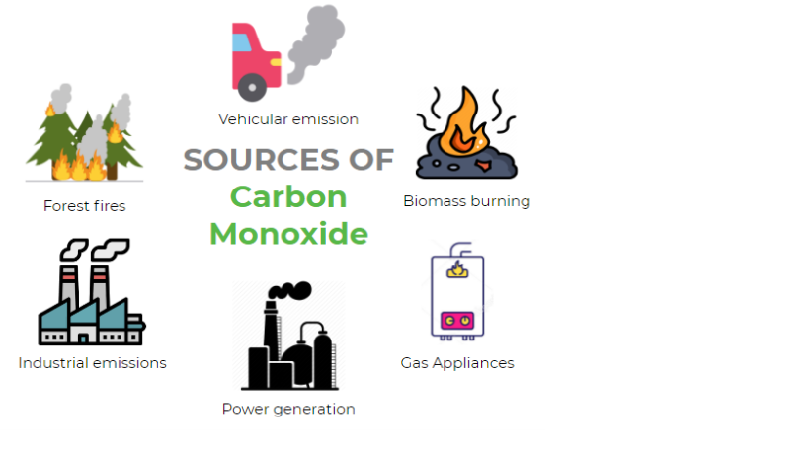

Slide 4
Goal
The purpose of this project is to detect and monitor Carbon monoxide on an independent platform. By using MQ7 sensor we can check or monitor the amount of Carbon monoxide.

Slide 5


Slide 6
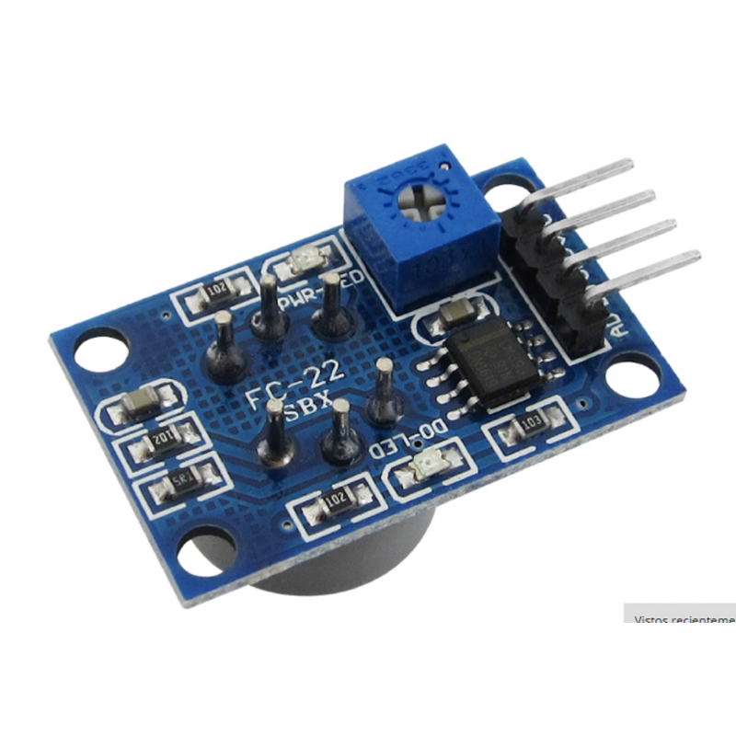
MQ7 Sensor This precision sensor is the best low-cost sensing solution for measuring Carbon Monoxide Gas.
Tools, Services and Libraries

Slide 7
Nuclio Nuclio is an open source and managed serverless platform used to minimize development and maintenance overhead and automate the deployment of data-science based application
Tools, Services and Libraries

Slide 8
RabbitMQ RabbitMQ is an open-source message-broker software which implements AMQP and has since been extended with a plug-in architecture to support MQTT and other protocols
Tools, Services and Libraries

Slide 9
NodeMcu is a low-cost open source IoT device that includes firmware, which runs on the ESP8266 Wi-Fi microchip, and hardware based on the ESP-12 module. NodeMCU has 128 KB RAM and 4MB of Flash memory to store data and programs. This device consists of 13 GPIO pins.
Tools, Services and Libraries

Slide 10
Docker is a project open source that automates the process of deployment of applications in software containers.
Tools, Services and Libraries

Slide 11
Arduino The Arduino Integrated Development Environment is a cross-platform application that is written in functions from C and C++. It is used to write and upload programs to Arduino compatible boards such as NodeMCU.
Tools, Services and Libraries

Slide 12
Nodered Node-RED is a tool for programming visually. It displays relations and functions visually, and allows the user to program without having to type a language. Node-RED is a browser-based flow editor where you can add or remove nodes and wire them together in order to make them communicate with each other.
Tools, Services and Libraries

Slide 13
Pubsubclient Is a client library for MQTT messaging, MQTT is a lightweight messaging protocol ideal for small devices. This library allows you to send and receive MQTT messages.
Tools, Services and Libraries

Slide 14
ESP8266 is the library support for the ESP8266 chip to the Arduino environment. It lets us write sketches, using familiar Arduino functions and libraries, and run them directly on NODEMCU
Tools, Services and Libraries

Slide 15
Implementation of Nodered
Installing Node-RED as a global module adds the command node-red to your system path. Execute the following at the command prompt:
npm install -g --unsafe-perm node-red
And To install the AMQP components, select the Manage palette option from the right side of the menu bar. Then search for “AMQP” and install node-red-contrib-amqp. If your installation of Node-Red does not have dashboards installed, search for: node-red-dashboard.
Then you have to search and install MOSCA from Manage palette.

Slide 16
And Nodes are added by dragging and dropped them into the center Flow sheet. Logic is created by making connection wires between inputs and output of a node. After the logic is laid out, double click on each of the nodes to configure their specific properties. You will need to specify the MQTT and AMQP definitions of your RabbitMQ IP address,user rights, MQTT topic and AMQP queue name. You will also need to double click on the gauge nodes to configure the look-and-feel of the web dashboard.
After the logic is complete, hit the Deploy button on the right side of the menu bar to run the logic. The Node-Red dashboard user interface is accessed by: http://ipaddress:1880/ui.

Slide 17
Application
Carbon monoxide is a very important industrial compound. In the form of producer gas or water gas, it is widely used as a fuel in industrial operations. The gas is also an effective reducing agent.
So, It is very important to know the exact quantity of carbon monoxide and my project helps to quantify the amount of carbon monoxide.
We can use this sensor in Factories and in Industries as well as in Homes to detect the level of CO, so we can take precautions on proper time and save our lives and others also.

Slide 18
Thank You

